Slide 1
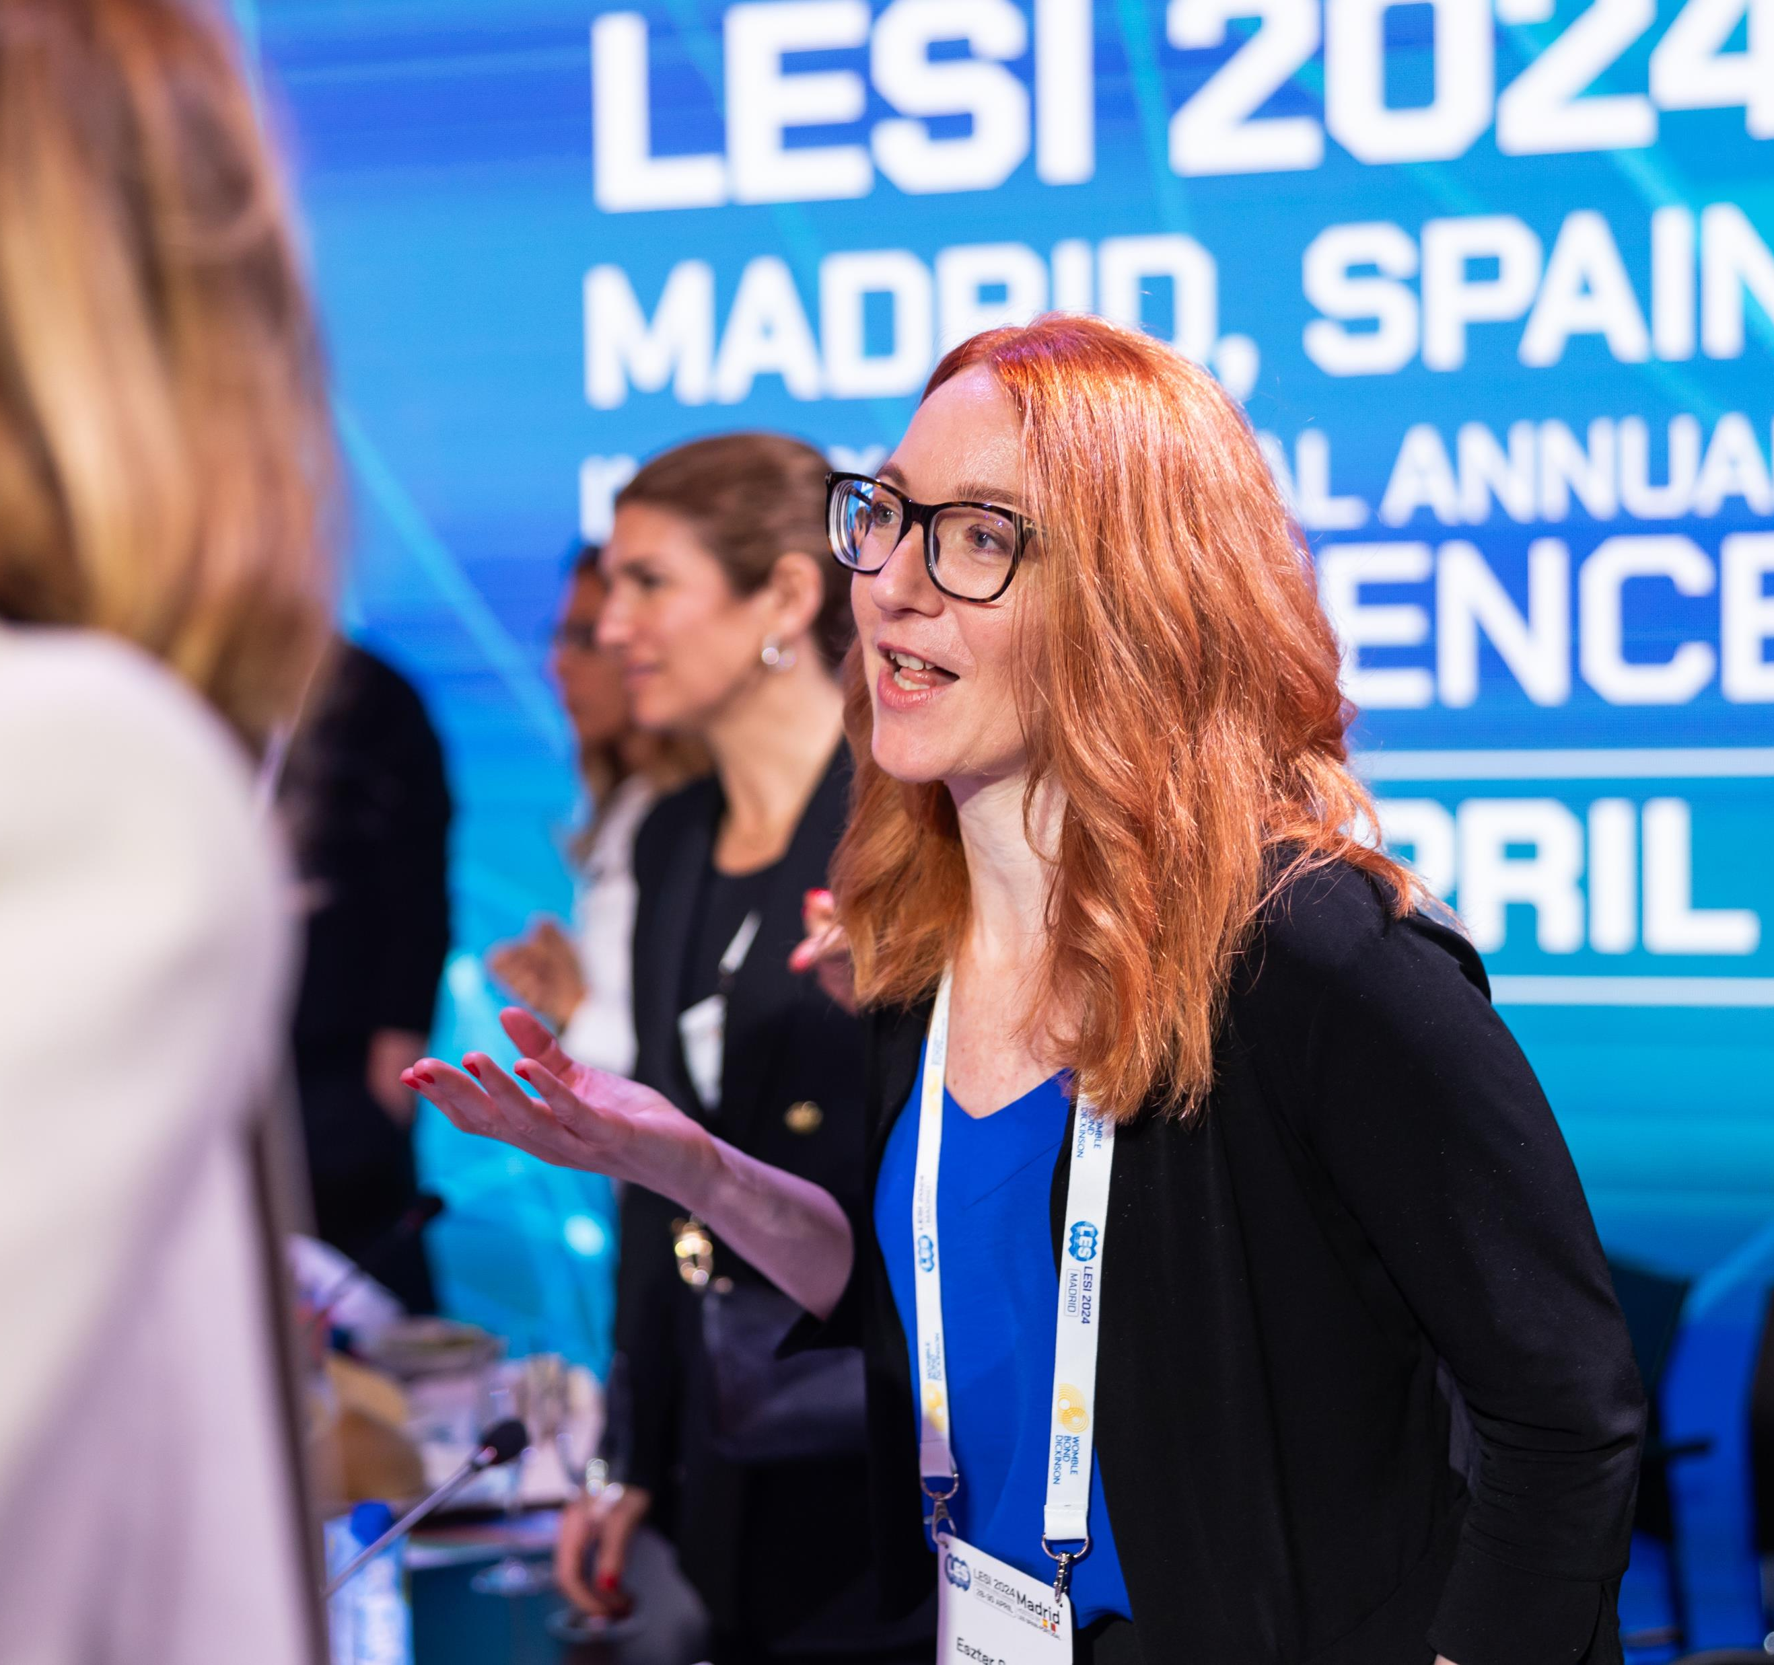
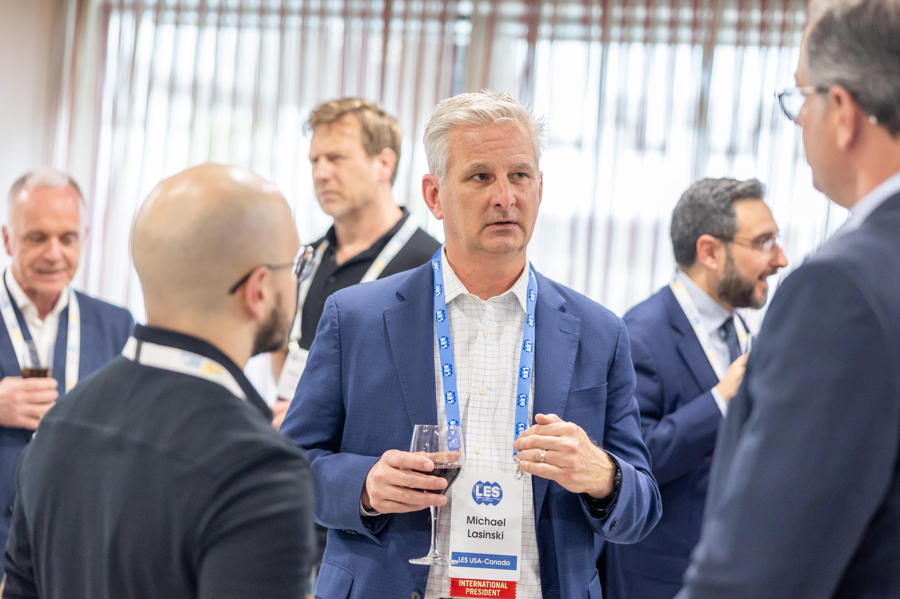
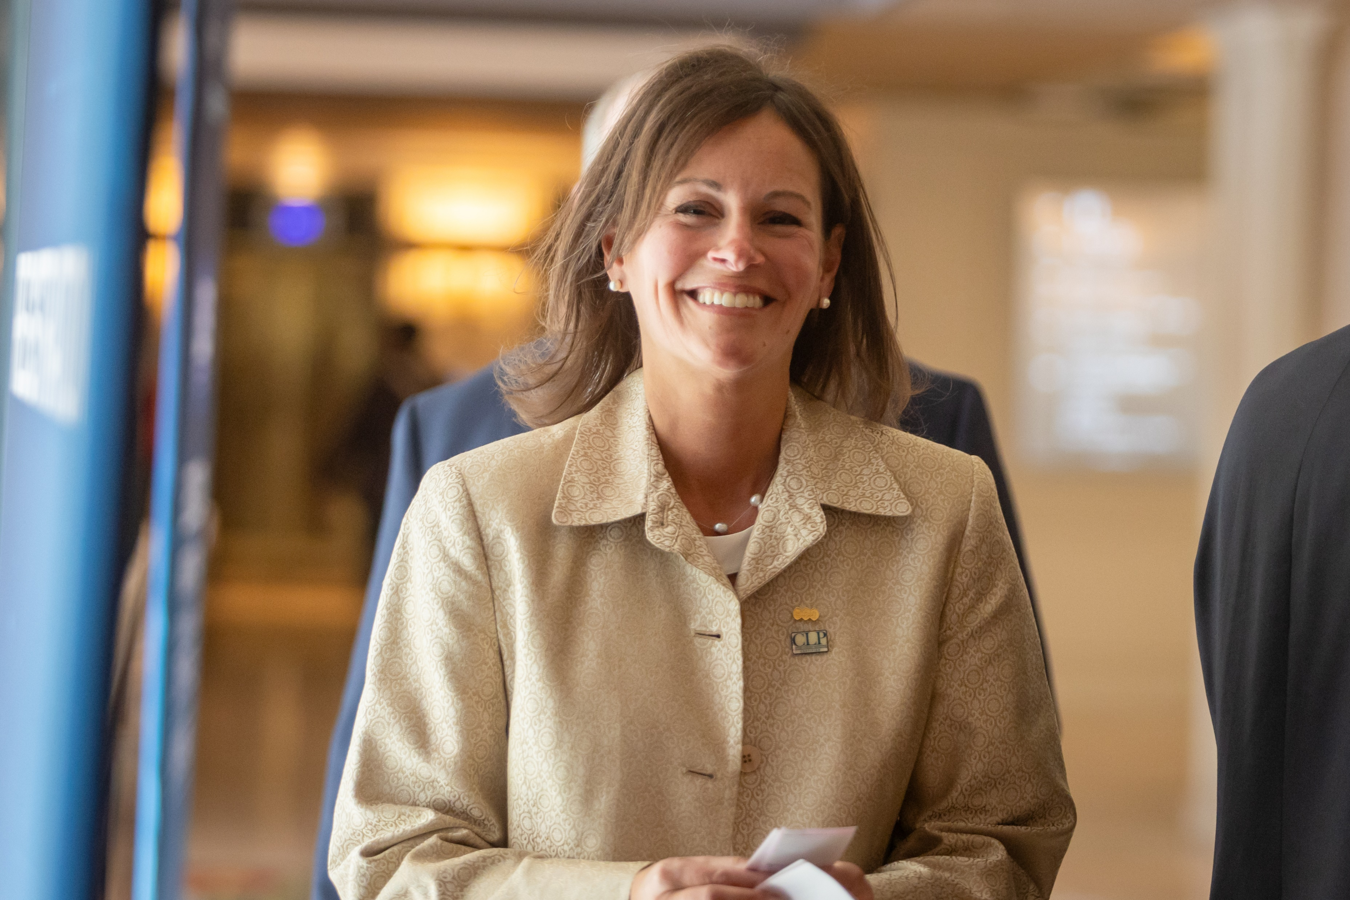
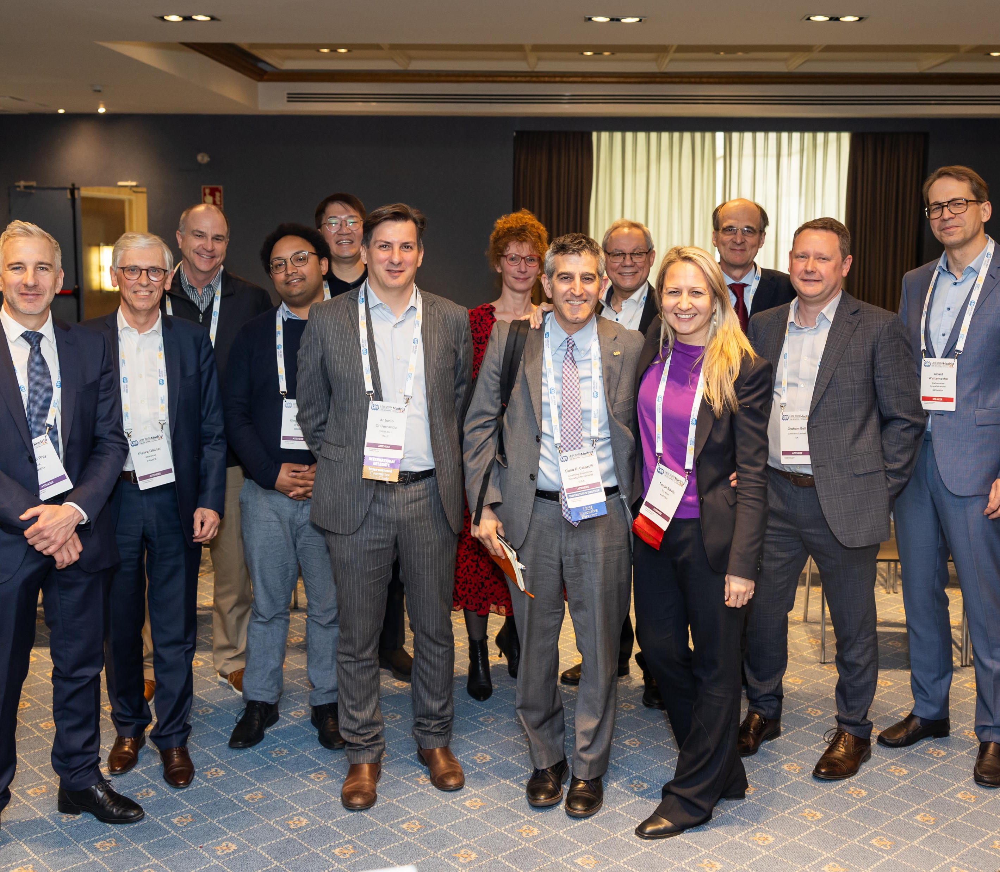
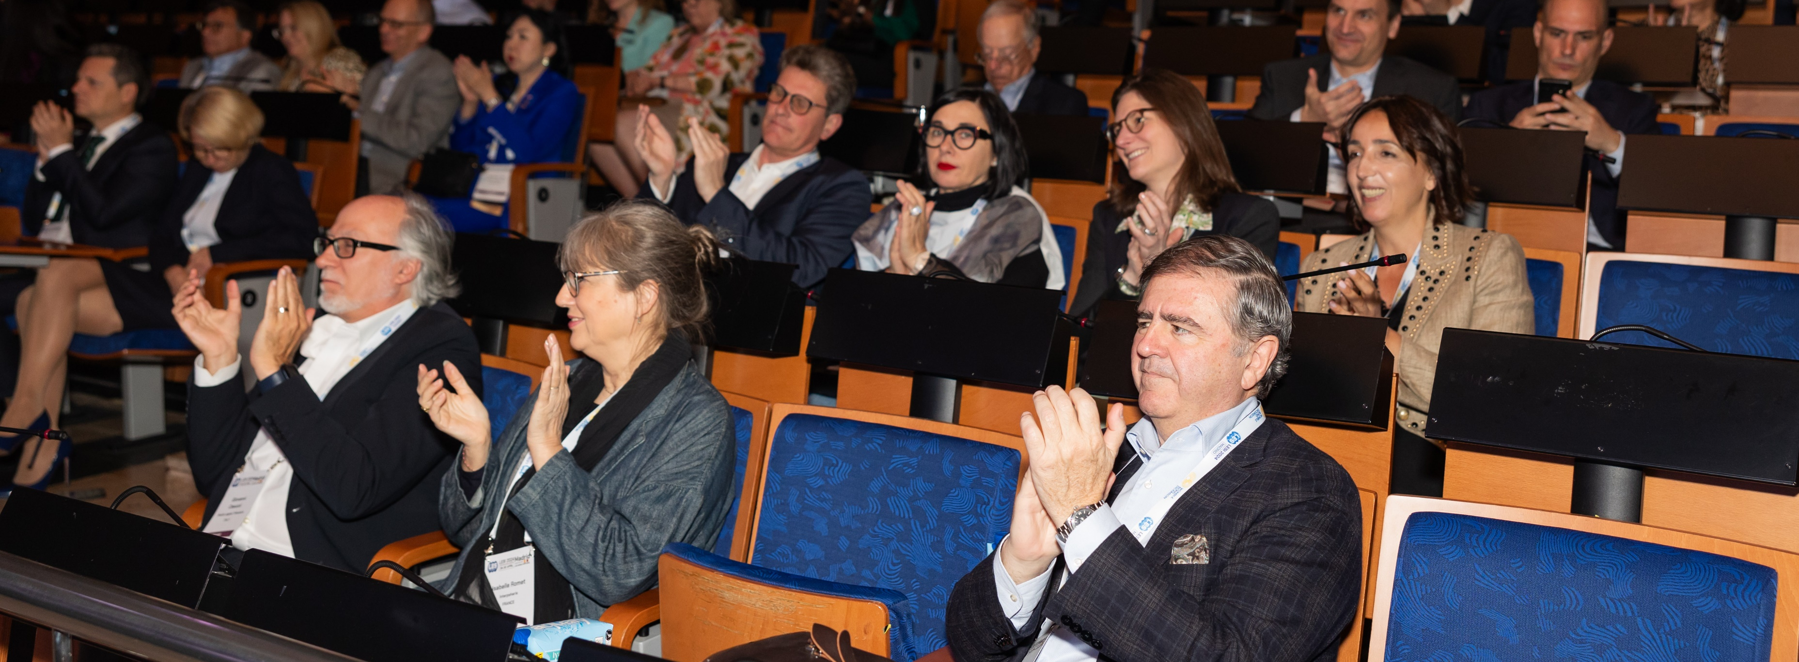
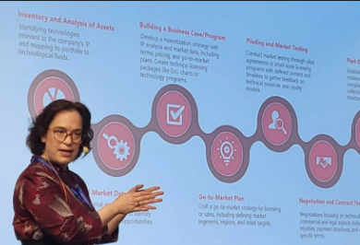
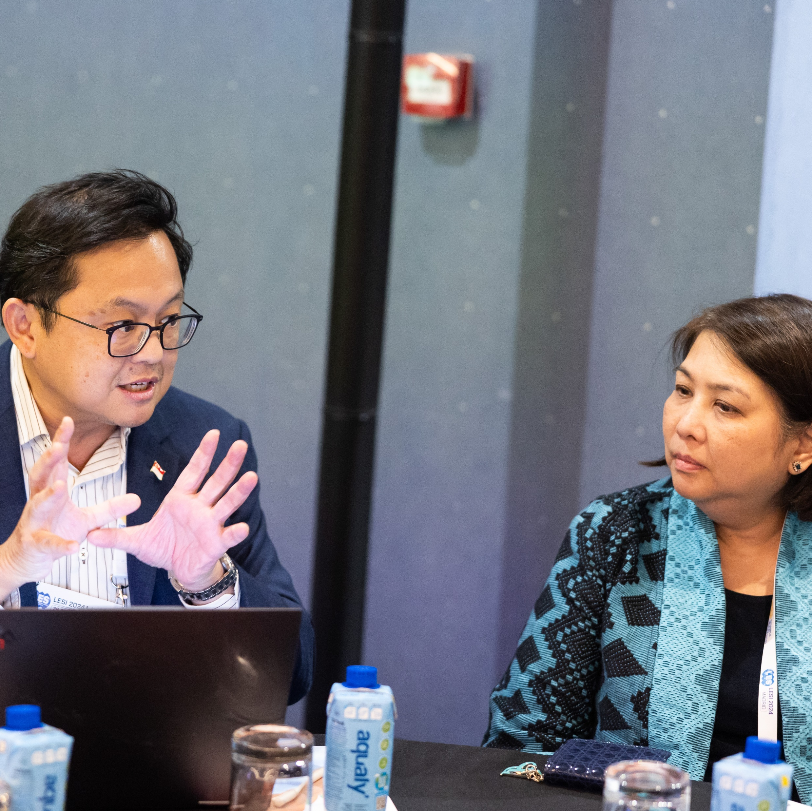
[Title / Cover #1]

Slide 2
[Title / Cover #2]

Slide 3
Body slide option #1

Slide 4
Body slide option #2

Slide 5
LESI:
We connect people and create opportunities

Slide 6
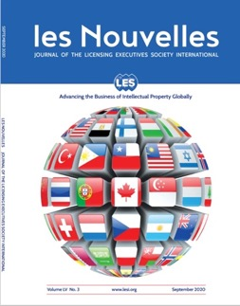
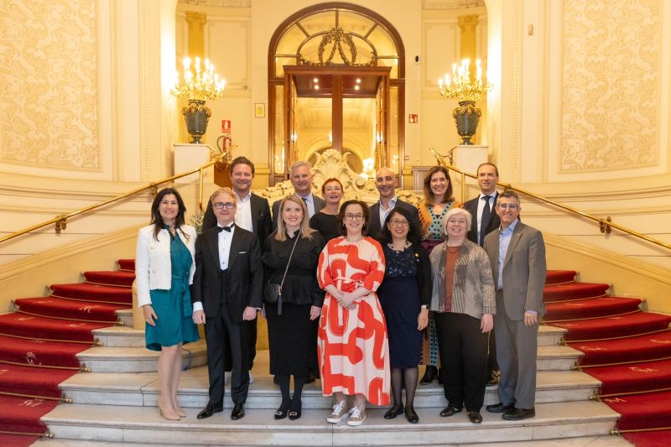
Who is LESI?
The Licensing Executives Society International (LESI) is a global association, established in 1973, of 33 national and regional Member Societies, in more than 90 countries, serving more than 6500 individuals.
We connect people and create opportunities.
We enable a global, collaborative and generous community, advancing the commercialization of intellectual assets
We bring creativity and innovation to the market, improving lives everywhere.
We are business leaders, IP managers, financiers and licensing executives. We are experts in law, valuation, protection, transfer, and enforcement of IP.
We advance the business of intellectual property.
LESI Board of Directors
2024-25
LESI: Advancing the Business of Intellectual Property Globally
Notes:
Who is LESI? Celebrating our 50th Year:
LESI is celebrating its 50th anniversary this year. We serve society by educating and disclosing our professional opinions on the business of IP. We are actively involved in recommending innovative products and technologies for daily life. We have more than 30 expert committees globally that can discuss the finer points of IP business and the value of IP, from negotiation to dispute resolution.
[Japanese translation – Ichiro Nakatomi]
LESIは今年で50周年を迎えています。 IPビジネスの教育や専門意見を開示することによって社会に貢献しています。私たちは生活に必要な革新的な商品や技術を推奨しており、IPビジネスの交渉から係争の解決やIPの価値まで細かなことまで話うことができる専門的なグローバルな委員会があり、活発な活動を行っています。

Slide 7
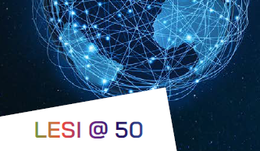
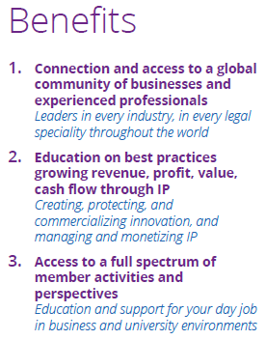
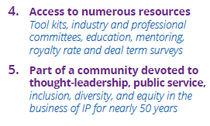

Slide 8
Advancing the Business of IP Globally

